Slide 1
Employee Data Analysis using Excel
STUDENT NAME: ABINAYA. V
REGISTER NO: 312209885
DEPARTMENT:B. COM Bank Management
COLLEGE:
Valliammal College for Women
1
Notes:
1

Slide 2
PROJECT TITLE
Employee Performance Analysis using Excel
2

Slide 3


AGENDA
Problem Statement
Project Overview
End Users
Our Solution and Proposition
Dataset Description
Modelling Approach
Results and Discussion
Conclusion
3/21/2024 Annual Review
3

Slide 4

PROBLEM STATEMENT
. Utilize Excel to efficently analyse employee data by leveraging
Function such as PIVOT TABLES, nad conditional formating.
. The enables the identification of key trends, such as current
Employees rates, performance levels.
Desicion-making processes by visualization this data through
Pie chart
4

Slide 5

PROJECT OVERVIEW
.
This project focuses on analysing employee data to identify trends and
And insights that can drive better decision.
Excel will be used to clean, organize, and visuzalise kry metrics such as
Employee demographics, performance, and rention rates.
The analysis will highlights areas of improvemnet in workforce management
Helping to optimize resource allocation.
Outcomes will iclude detailed reports and dashboard for management
Review.
The finding aim to support stratergic planning.
5

Slide 6
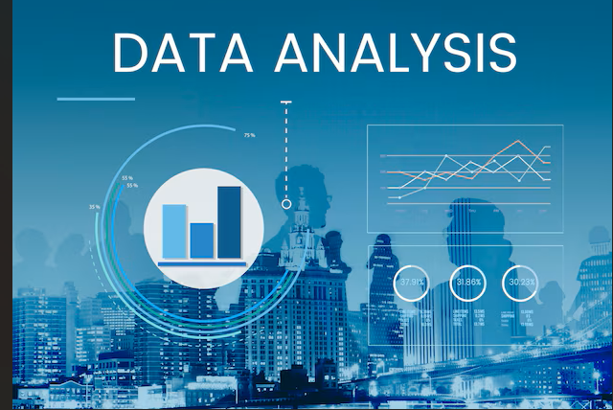

WHO ARE THE END USERS?
The end users of the employee data employee data analysis are HR
Managers team leads and senior management.
6

Slide 7

OUR SOLUTION AND ITS VALUE PROPOSITION
Conditional formatting – highligths missing cells
Filter – helps to remove the empty cells
Formulas – helps to identify the performance of emloyees
Pivot table – helps summarize
Pie chart – shows the data
7

Slide 8
Dataset Description
1. Employee ID
2. First name
3. Last name
4. Business unit
5. Employee classification type
6. Employee type
7. Gendor
8. Performance score
9. Current employee rate
10. Performance level

Slide 9

THE "WOW" IN OUR SOLUTION
Performance level
1. Tables: Create a table in PPT to display the data. You can copy and paste the data from Excel into the table.
2. Charts: Use charts to visualize the data, such as:
- Bar chart to show salary ranges
- Pie chart to display the distribution of employees by location
- Scatter plot to show the relationship between salary and location
3. Graphs: Use graphs to display the data, such as:
- Histogram to show the distribution of salaries
- Heat map to display the concentration of employees by location
4. Summary statistics: Calculate summary statistics (e.g., mean, median, range) for the data and present them in a PPT slide.
3/21/2024 Annual Review
9

Slide 10
MODELLING
DATA COLLECTION
*Identification
*Gathering
*Preparation
DATA CLEANING
*Standarization dization
*Correction
*Validation
SUMMARY
Data analysis involves examining, transforming, and modeling data to
Extract insights , identify patterns, and support decisions-making.
10

Slide 11
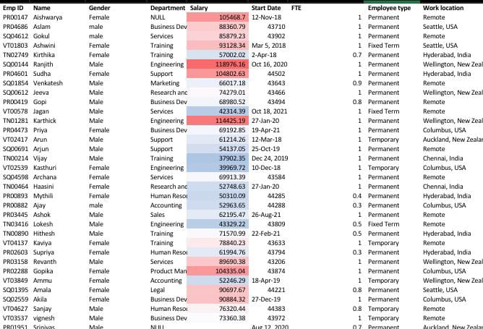
RESULTS
11

Slide 12
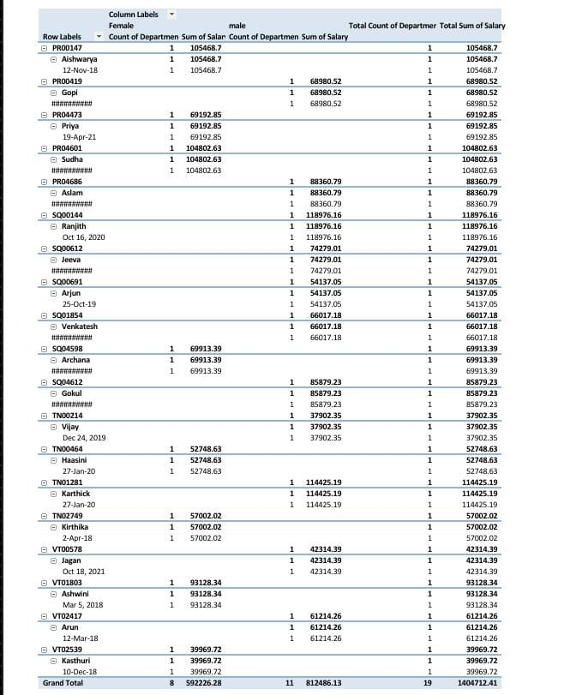

Slide 13
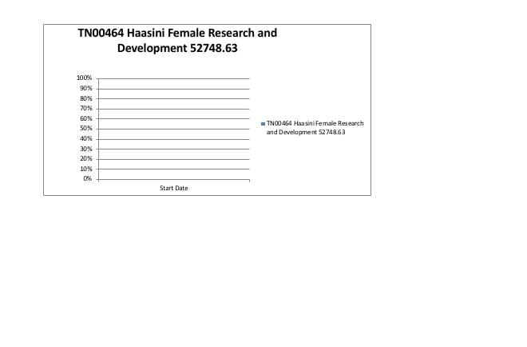

Slide 14
conclusion
* IN CONCLUSION, the employee data analysis conducted using Excel
Provided valuable insights into workforce trends enabling more
Infromed decision-making.
The use of Excel allowed efficient data organization, visualization
and reporting, ultimately helping to enhance HR strategies, improve
and employee satisfaction and optimize overall organizational
performance.

